Slide 1
Saudi Arabia Used Car Market
By:
Raghad Al Malki
Ahmed Al Subhi
Fahad Al Saadi
Salman Gassem

Slide 2
CONTENTS
01
Largest Market
The largest market by region in Saudi Arabia
02
Car Brand
The most car brand listed for sale
03
The Most Significant Features
The most significant features influence on the price of a used car
04
The Price Range
the price range for used cars that are approximately four years old
05
Gear Type
The most sold transmission, manual or automatic?

Slide 3
Data Description
Syarah, online app used car seller
Rows: 5624
Columns: 11
Data Types: Strings, numbers, and Boolean
No Null values
Year: 2023

Slide 4
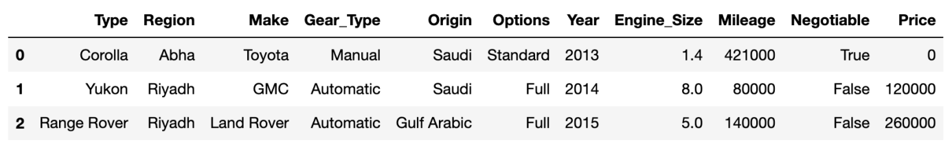
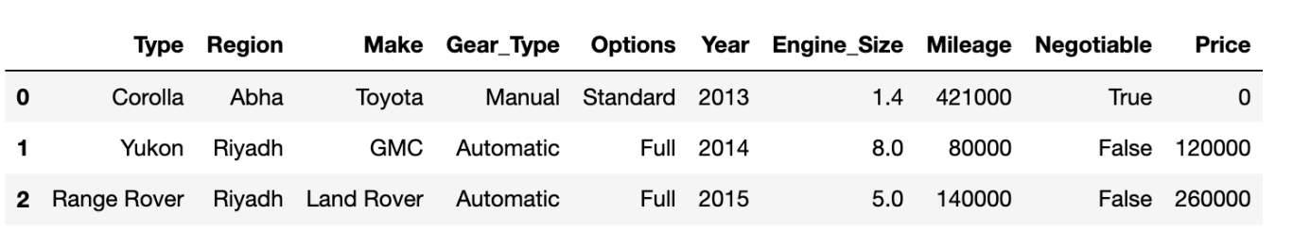
Data Cleaning:
Before:
After:

Slide 5
Results

Slide 6
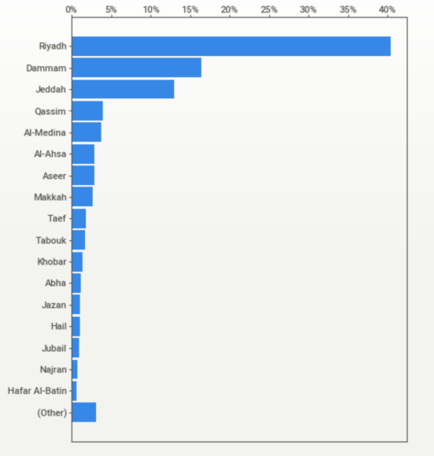
01. Largest Market
The largest market by region :

Slide 7
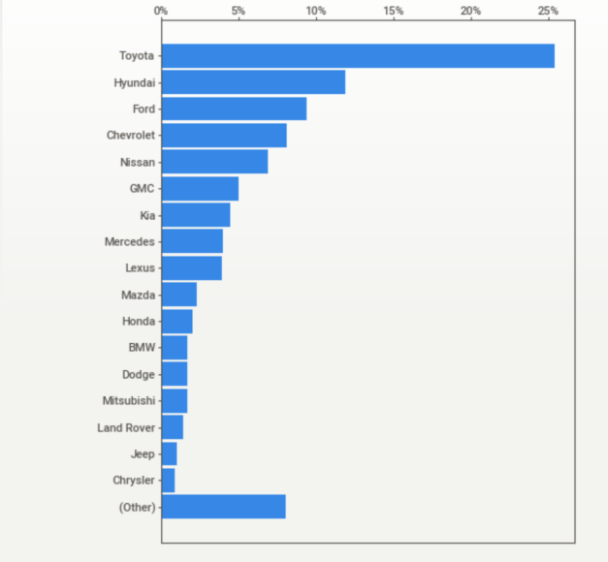
02. Car Brand
The most car brand listed for sale:

Slide 8
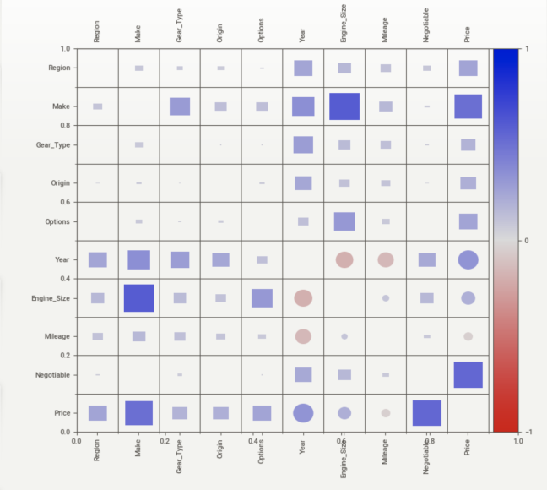
03. The Most Significant Features
The most significant features influence on the price of a used car

Slide 9
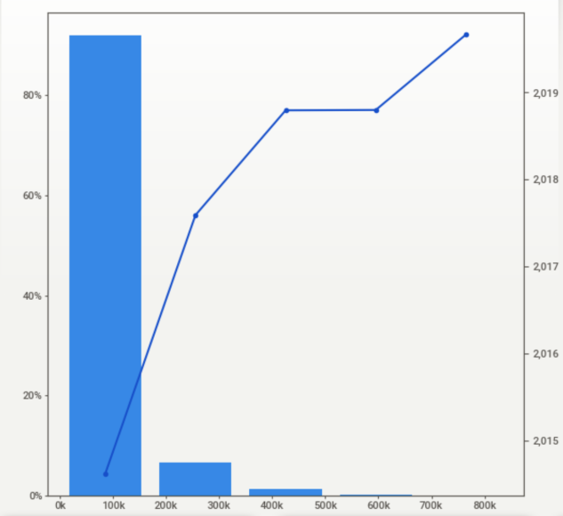
04. The Price Range
the price range for used cars that are approximately four years old

Slide 10
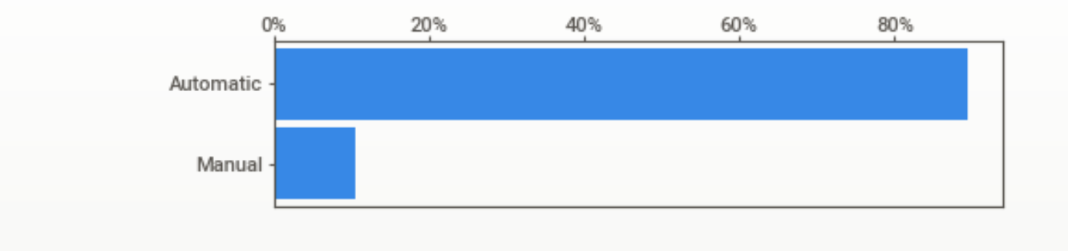
05. Gear Type
The most sold transmission, manual or automatic?

Slide 11
THANK YOU

